Slide 1
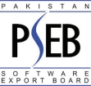
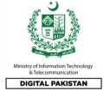

Slide 2
GLOBAL STATISTICS
8.85
TOP 10 ICT EXPORTING
COUNTRIES FY 2019-2020
7.73
3.53
2.83
2.15
7.08
USA
UAE
UK
Singapore
Canada
Malaysia
1.97
1.97
1.88
1.26
In Percentage
China
Germany
Ireland
KSA
57.56

Slide 3
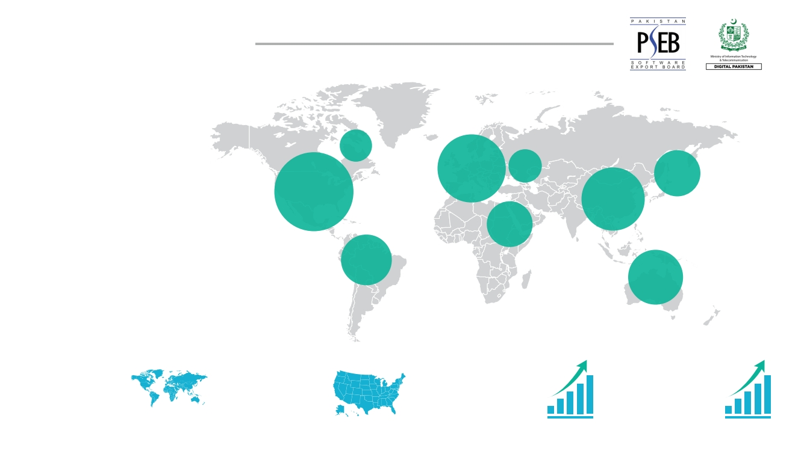
GLOBAL STATISTICS
2%
20%
3%
7%
32%
14%
5%
6%
11%
TOP 10 ICT EXPORTING
COUNTRIES FY 2019-2020
$5.2
trillion
global technology industry
(2019 projection)
$1.7
trillion
U.S technology industry
(2020 projection)
3.7%
global growth projection
(2020 projection)
5.4%
optimistic upside growth
projection
(2020 projection)

Slide 4
Pakistan IT & ITeS Export Remittance
(As per State Bank of Pakistan)
PAKISTAN STATISTICS
Million US$

Slide 5
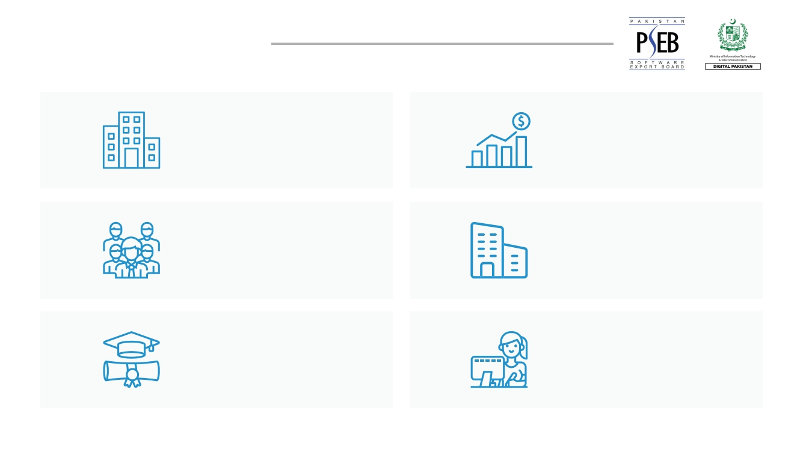
PAKISTAN STATISTICS
5000+
Companies
500,000
IT Professionals
25,000
IT Graduates
$1.23 Billion
Export Revenue
300+ International
Companies
3rd In Freelancing
Industry

Slide 6
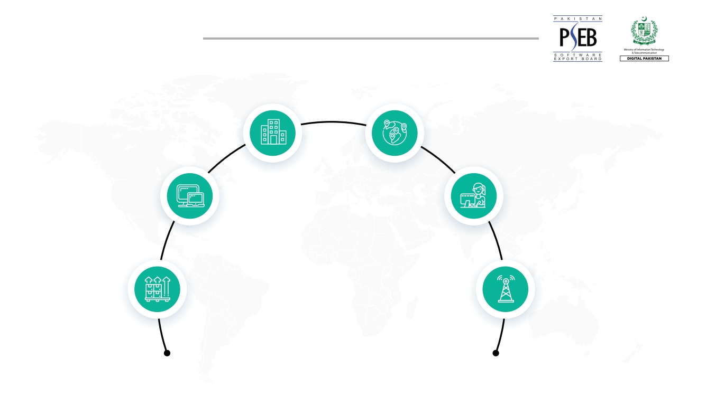
CURRENT STATUS
300+ International Companies
Bentley®, Ciklum®, IBM®, Mentor Graphics®,
S&P Global®, Symantec®, Teradata®, VMware® etc. have established BPO support,
development & global consulting centers
14 Software
Technology Parks
Exporting to
100+ Countries
5th Most Financially Attractive Country
in the world for outsourcing services
(A.T. Kearney’s Global Services Location Index 2019)
3rd Most Popular
Country For Freelancing
(Oxford Internet Institute (OII), ‘Online Labor Index’ 2018)
Well Developed
Telecom Infrastructure
6 international cables &
4 mobile operators
PAKISTAN ’S
IT & ITES SECTOR

Slide 7
CURRENT STATUS
International Clients
Pakistani IT companies have many Fortune 500 compa- nies amongst their clients including Halliburton®, Motorola®, GE®, BMW®, Toyota®, Daimler Chrysler®, AT&T®, Vodafone®, e-Bay®, Pepsi®, Deutsche Tele- com®, DHL®, KPMG®, ABN Amro®, NYSE®, British Petroleum®, Petronas®, Caltex®, Sears®, Telenor®, and many more.
Emerging Technologies
GOV-Tech (NADRA)
Med-Tech (Tele-Medicines)
Edu-Tech (Taleem Ghar, Tele-education)
Agri-Tech
Excellence Centers
Many international IT firms have established offices in Pakistan including IBM®, HP®, Dell®, Intel®, Microsoft®, Oracle®, Siemens®, NCR®, Teradata®, Mentor Graphics®, and many more
Certified IT Companies
More than 150 IT companies are certified in IT quality standards such as ISO 9001, ISO 27001 and Carn- egie Mellon’s CMMI.
PAKISTAN ’S
IT & ITES SECTOR

Slide 8
TOP 20 ICT EXPORT DESTINATIONS FY 2020 (STATE BANK OF PAKISTAN TRADE DATA (JUL 2019 – JUN 2020)
Rank
Country
% Share
Rank
Country
% Share
1
2
3
4
5
6
7
8
9
10
U.S.A
U.A.E
U.K
Singapore
Canada
Malaysia
Germany
China
Ireland
Saudi Arabia
57.56 11 Norway
8.85 12 Netherlands
7.73 13 Australia
3.53 14 Bahrain
2.83 15 Sweden
2.15 16 Japan
1.97 17 Switzerland
1.97 18 Denmark
1.88 19 Indonesia
1.26 20 Qatar
1.14
1.09
1.14
1.14
1.14
1.14
1.14
1.14
1.14
1.14

Slide 9
AREAS OF EXPERTISE
PRODUCT DEVELOPMENT
1
2
3
4
5
6
7
8
CRM Software (Sales & support automation)
Data Warehousing & Business Analytics
Embedded Systems Software
Exploration & Production Software Banking (Core Banking, Banking Apps)
IT Consulting & Systems Integration
e-Learning & Education Software
Telco & Billing Software
9
10
11
12
13
14
15
16
Exploration & Production Software
Open-Source Customization
Product Design, Development & Testing
ERP (General, Specialized – Verticals)
Information Security, IT Governance & Strategy Virtualization & Cloud Computing
Mobile Apps Design & Development
Health related Software

Slide 10
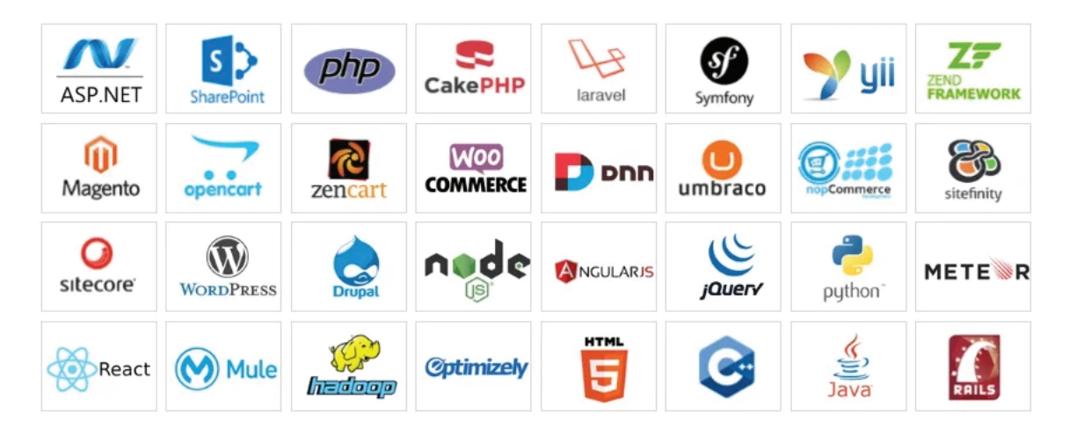
TECHNICAL EXPERTISE
PRODUCT DEVELOPMENT

Slide 11
WHY PAKISTAN
SPECIAL TECHNOLOGY ZONES ORDINANCE
1. New STZ ordinance passed under which Special Technology Zones (STZs) will be set up in different cities where technology companies can have modern and cutting-edge infrastructure
2. STZs will have tech companies, centers of excellence for technology research, banks, hotels, community centers and residential areas
3.
4.
The clusters will be governed by the Special Technology Zone Authority (STZA) Incentives from the date of issuance of a license by STZ Authority include the following
Exemption from general sales tax (G.S.T) on goods and services on import of plant, machinery, equipment, and raw materials for the consumption of these items within zones by the Authority as well as zone enterprises
Tax exemption on dividend income and long-term capital gains from investments in a venture capital (VC) for a period of ten years
Supply of uninterrupted power and other resources Guaranteed high-speed internet for the companies as well as the data centers which will be established inside the STZs
Exemption from all income taxes (withholding tax, presumptive tax) for a period of ten years
Exemptions from all customs duties and taxes on capital goods including but not limited to materials, plant, machin- ery, hardware, equipment, and software imported into Pakistan
Exemption from property tax for ten years

Slide 12
WHY PAKISTAN
FRIENDLY POLICIES
Software Technology Zone Ordinance New STZ ordinance passed due to become an act
providing most attractive incentive programs for IT investment with zero taxes
Depreciation
Accelerated depreciation of 30% on
computer equipment
Equity
100% equity allowed for foreign
investors
Software Technology Parks Provision of low rent space in Software
Technology Parks (STPs)
10 Years Local & International Tax Holiday Exemption from all income taxes (withholding tax, presumptive tax), property tax for 10 years from date of issuance of a license by STZ Authority
Repatriation
100% repatriation of dividend and investment allowed to foreign IT investors
Cost-Effective Real Estate
Turning around defunct factories into technology business hubs housing one or more companies
Other Benefits
Supply of uninterrupted power and other resources & guaranteed high-speed internet for companies as well as data centers which will be established inside the STZs
GOVERNMENT
INCENTIVES

Slide 13
WHY PAKISTAN
LOCATION, LABOR, LOCAL ECO-SYSTEM
1
3
High Broadband Users
3 Million Telephone subscribers
87 Million Broadband subscribers
169 Million Cellular subscribers
85 Million 3G/4G subscribers
Spring Board Pakistan
Pakistan - Center of the World
Internet corridor for Central Asia, Eastern part of China, GCC, Africa, South East Asia, Oceania
5 Hours Advantage – 5 hours behind Melbourne,
5 hours ahead of London
Destination for IT services excellence centers and back offices
2
4
Cost Effective Operations
70% savings on opex
Tax exemption on dividend income and long-term capital gains from investments in a VC undertaking for 10 years Custom duty waiver for export services and operations Low Cost and Skilled Labor Pool
Startups Eco System
Startups Eco-systems including
Fintech, Edu-tech, Social Transports, Healthcare, Marketing, Real Estate, Automobiles, Food Business

Slide 14
WHY PAKISTAN
FINANCIAL RAILROADS
International
e-Payments/Merchant
Accounts
Facilitation of Freelancers
Bank Loans/Financing
Bank Financing
Merchant accounts are enabled
06 banks and 02 ecommerce merchant aggregators are providing internet payment gateway services
Rules of Digital On-Boarding of small merchants with simplified due diligence in place
Inward remittance limit for freelancers enhanced to $25,000/individual/month
35% of export earnings received through home remittance channel can be used to make payments abroad Opening of bank accounts after fulfilling KYC/CDD requirements
Export remittances of IT & ITeS Freelancers are being reported and merged with industry’s export remittances
Secured Transactions Registry (SME access to credit using movable assets as collateral: stocks, receivables, patents, trademarks, copyrights
Foreign currency loans from abroad: working capital, project financing, bridge financing, import/export loans Working capital financing for SMEs (Small: Rs. 25 million, Medium: 50 million.)
Export Finance Scheme
Transaction based facility: Firm Export Order / Export Letter of Credit, for a maximum period of 180 days Revolving finance limit equivalent to 50% of export performance during last year)
1
2
3
4

Slide 15
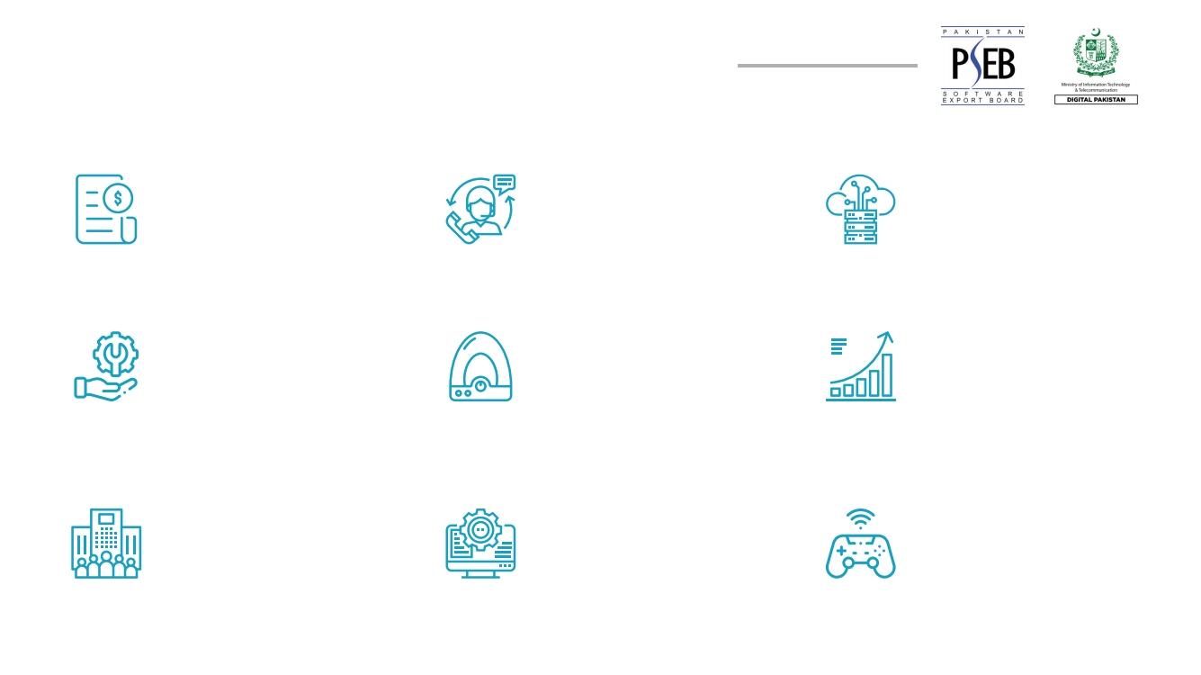
INVESTMENT OPPORTUNITIES IN PAKISTAN
Billing Centers
Call Centers
Data Centers
IT Consulting
Centers
Technology
Incubators
High Growth
IT Startups
Company Acquisitions
& Mergers
Software Development
Centers
Gaming & Animation
Studios

Slide 16
THRIVING STARTUP ECO-SYSTEM OF PAKISTAN

Slide 17
SUCCESS STORIES OF PAKISTAN
At Pakistan Canada ICT Forum 2017, E care Vision and Pegasus Consultancy jointly launched “Refer a Physician” product in Canada.
Tkxel secured a lead at Pakistan Canada ICT Forum 2017 with Markitech and done nearly $200K+ worth of business with them.
BroadPeak Technologies selected Microsoft Azure o house some of the most successful, application-hungry franchise businesses in the world.
The development makes VisionX the first and only US-Pakistan based technology company to win this coveted title. The ranking puts VisionX in the company of global innovation giants like Microsoft and Snap.
In October 2018, Tez Financial Services closed a seed investment round of $1.1 million led by Omidyar Net- work, established by Founder eBay Pierre Omidyar. Other investors included Accion Venture Lab and Planet N.
In September 2018, a startup, Auto Sahulat, closed a pre-seed funding round of $100,000 from a Singa- pore-based VC firm, Antler; an online service for road- side vehicle breakdown that connects mechanics with drivers for road-side assistance through mobile and web-based platform.
Pakistan’s global technology giant Systems Limited has made it to Forbes Asia’s Best Under a Billion 2020 list.
At CEBIT Australia 2017 event, Motioncue was able to enter in a partnership with Image Online to promote video production services in Australia.
At MWC Americas 2017, Mr. Hisham Malik, CEO - Arkhitech was able to secure contract of almost USD 25K per year. The contract is the beginning and hopefully the lead will mature
In March 2018, it was announced that Ant Financial Services Group, formerly known as Alipay, has invested $184.5 million for a 45 percent stake in Telenor Microfinance Bank.
Pakistan-based Computing Solutions (Pvt) Ltd (CSP) has won a unique honor for the country – the “Jona- than Scutt Memorial Technical Excellence Award 2020”.
The Talent Games, a Pakistan-based startup turned into a scale-up company, has won an award for the ‘Best Candidate Experience’ by a solution provider at the Asia Recruitment Awards 2020 in Singapore

Slide 18
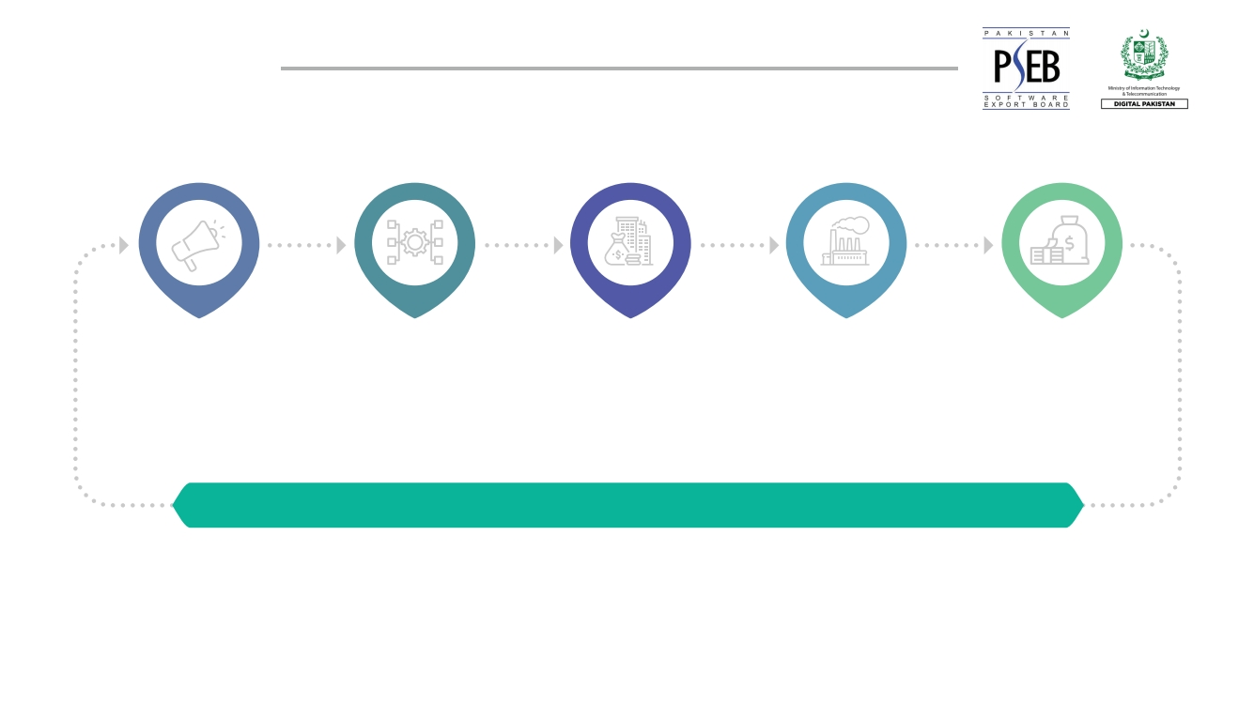
ABOUT PSEB
Marketing
& Business
Development
Infrastructure
Human
Capital
Development
Industry
Facilitation
Capital
Availability
LEADING GLOBAL BUSINESS DEVELOPMENT AND MARKETING ORGANIZATION
A front leading global business development and marketing organization which helps in development of the
IT industry and human capital behind the borders and generates demand from beyond the borders

Slide 19
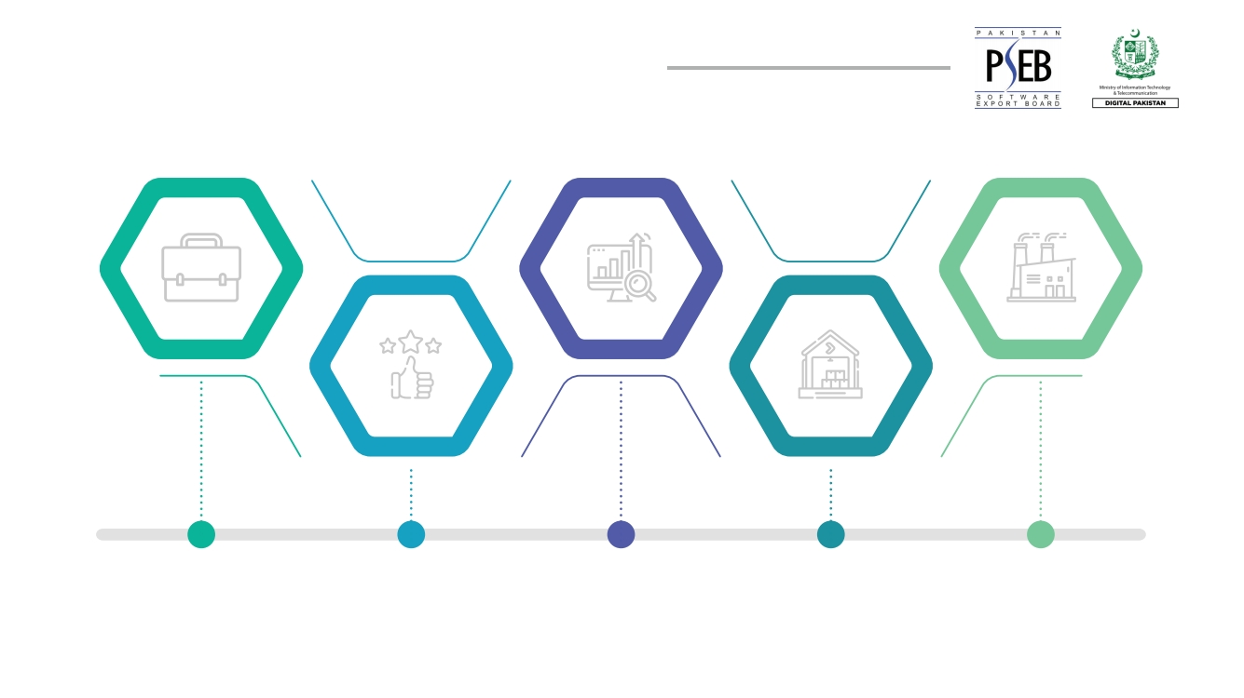
PSEB INDUSTRY SUPPORT PROGRAMS
Establishment of
IT Parks & STPS
Domestic business
facilitation
International
marketing & promotion
Industry capacity
building
Industry advocacy
& policy making

Slide 20
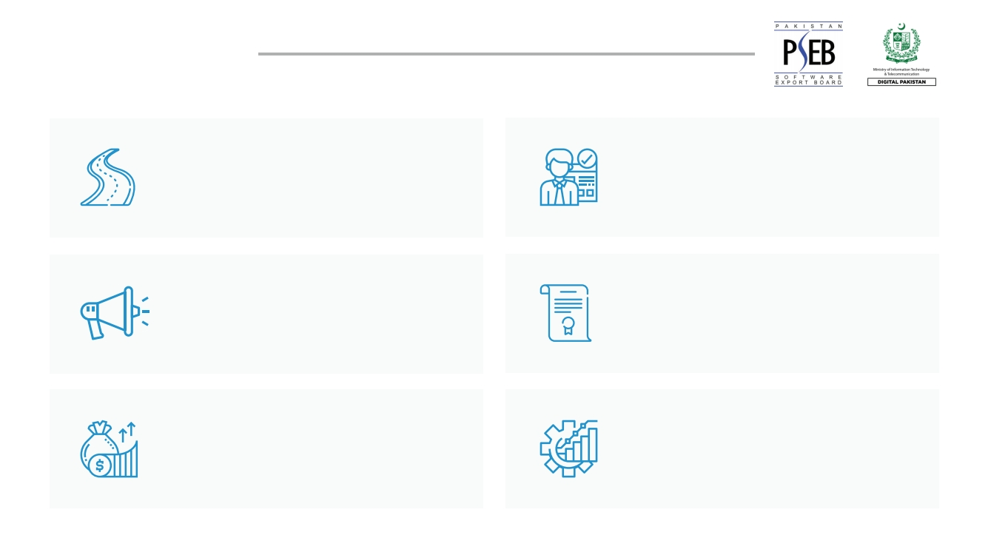
NEW PROJECTS
Infrastructure
Establishment of 25 STPs in Pakistan
Human Capital Development
ICT Internship Program
Marketing
Destination Tech Pakistan
Access to Capital
Raising capital of SMEs through PSX
Policy & Consulting
GDPR Compliance System & Freelancing Incorporation Drive
Business Development
International Business offices
at 4 Regions

Slide 21
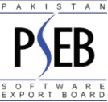
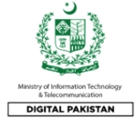
Hunza
SECONDARY CITIES
SOFTWARE TECHNOLOGY
PARKS INITIATIVE
Gilgit
Skardu
Swat
Malakand
Mardan
Muzaffarabad
Abbottabad
Peshawar
Islamabad
Bannu
Rawalpindi
Mirpur
Gujrat
Gujranwala
Sialkot
DI Khan
Sargodha
Lahore
Faisalabad
Sahiwal
Quetta
Multan
Bahawalpur
Khuzdar
Sukkur
Larkana
Turbat
Nawabshah
Gwadar
Hyderabad
Karachi

